Slide 1
AUTO MICOMS WRITING SYSTEM
TECHNICAL TEAM
2020. 10. 28
DEV 제조1팀

Slide 2

Contents
Block diagram
Software
User interface
Software main function
Setting/creat model
Report manager
Arduino controller board
Conveyor

Slide 3
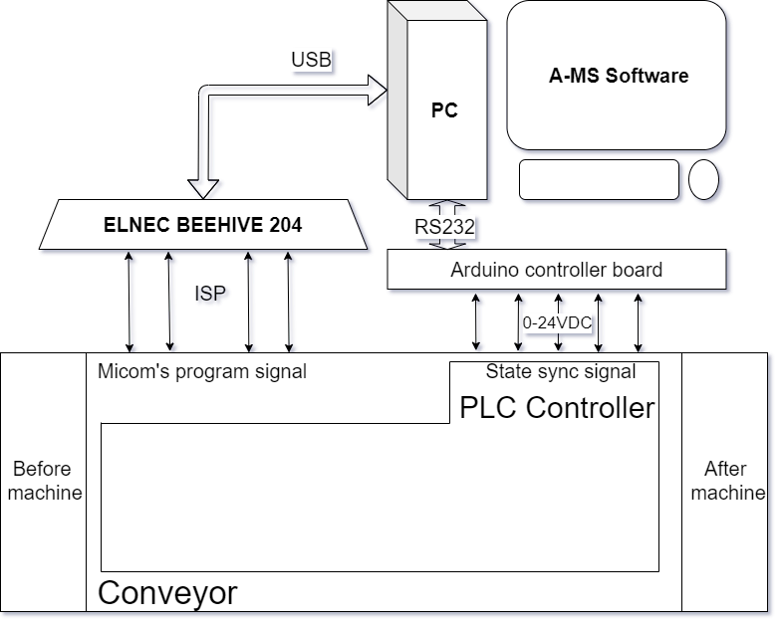
1. Block diagram
Run/Stop conveyor
Up/down Jig
Warning bug
Push NG board

Slide 4
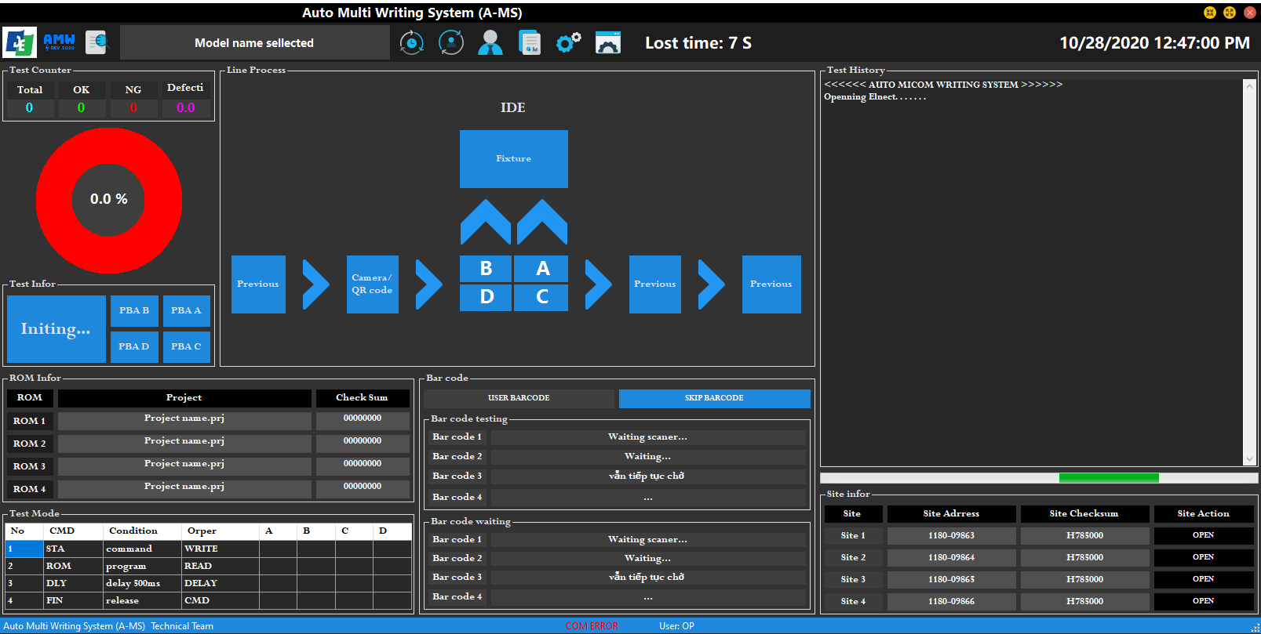
2. Software
a. User interface (Main window)
Toolbar
Statistical
History
Machine layout
Result
ROM info
QR code
Step run
Elnec info

Slide 5
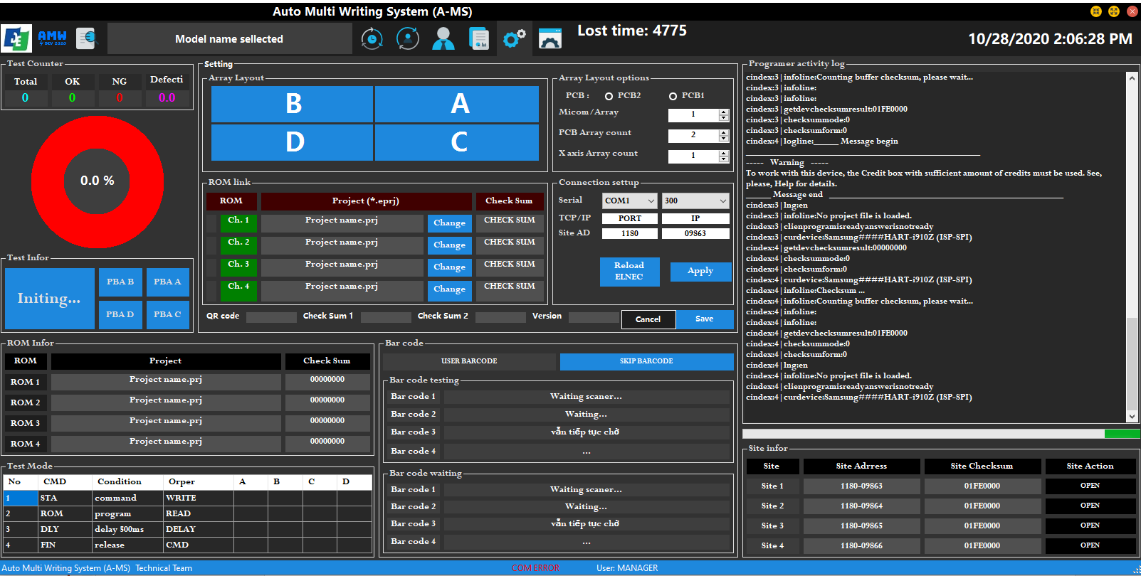
2. Software
a. User interface (Main window)
JIG layout setting
Elnec programmer log
ROM setting
Connect setting

Slide 6
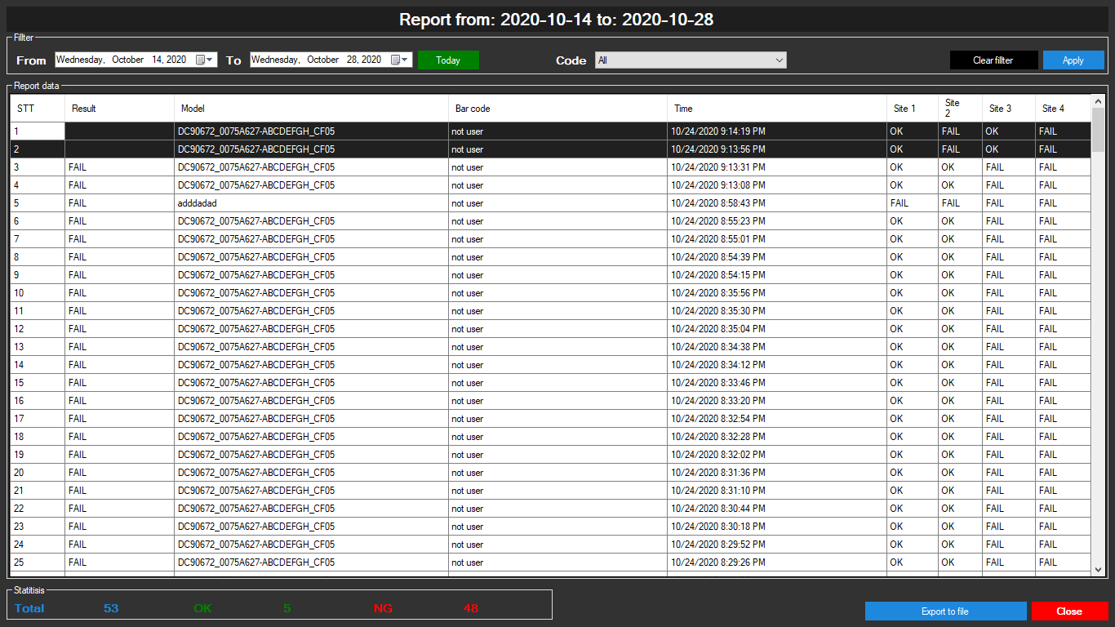
2. Software
a. User interface (Report window)
Report date filter
Report code filter
Report data
Report Statistical
Window action

Slide 7
2. Software
b. Software main function
Load the program at the same time for 4 MCU
Programs at different websites can be the same or different, up to 4 programs
Create new programs on demand.
Summarize the results, shown "ON", "FAIL" slot by slot
Display logs from Elnecs programmer, use them for debugging situations when unexpected errors are encountered
Export and manager report files, filter and export results independently.
Statistics of the number of OK / FAIL, calculate the rate of FAIL in the day.

Slide 8
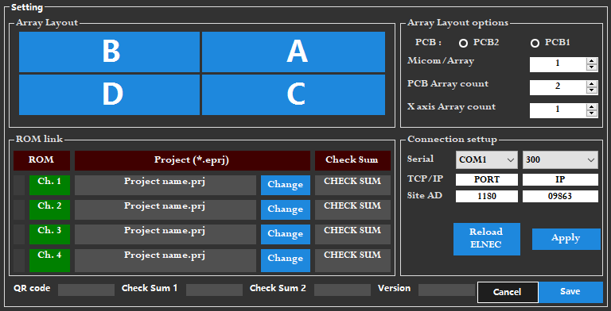
2. Software
c. Setting/creat model
Preview JIG layout
JIG layout setting
Connections setting
Model name form
ROM links and ROM checksum

Slide 9
2. Software
c. Report manager
Fil data by date
Fil data by code
Export data to txt file
Easy see “FAIL” result with a different background color.

Slide 10
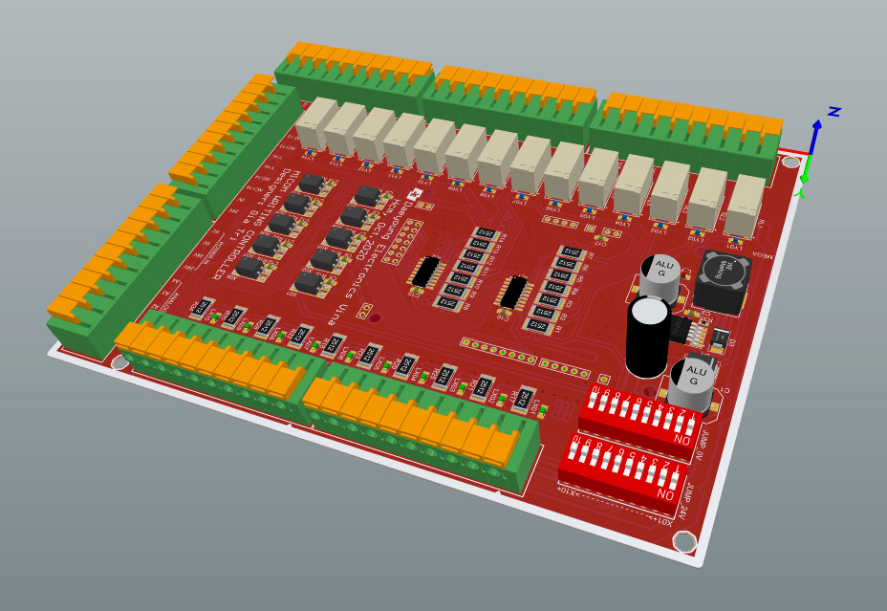
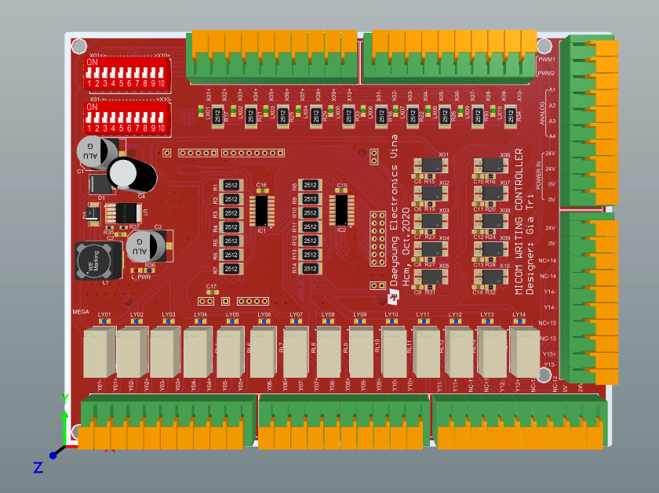
2. Arduino Controller Board
Connection and state synchronization between software and PLC on the conveyor belt.
Carousel activity simulation sample for software testing

Slide 11
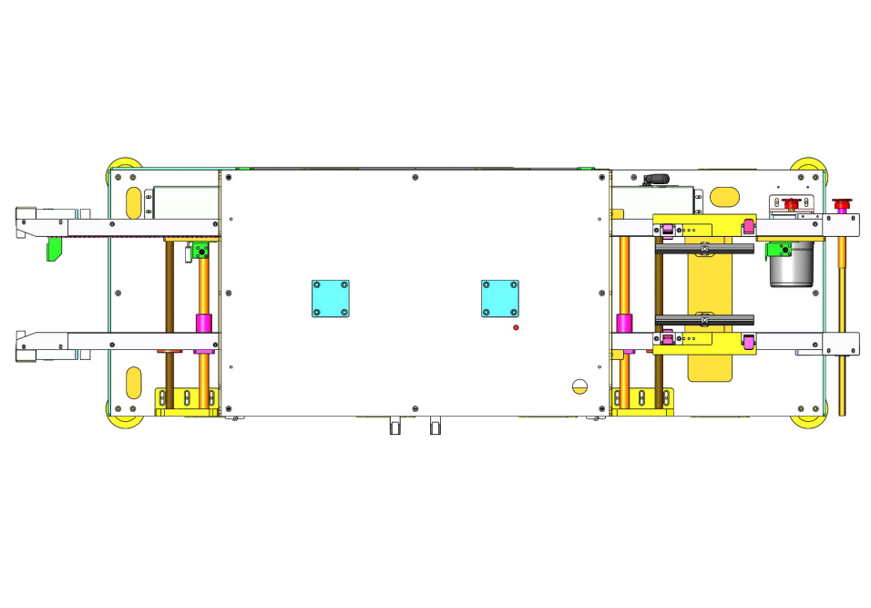
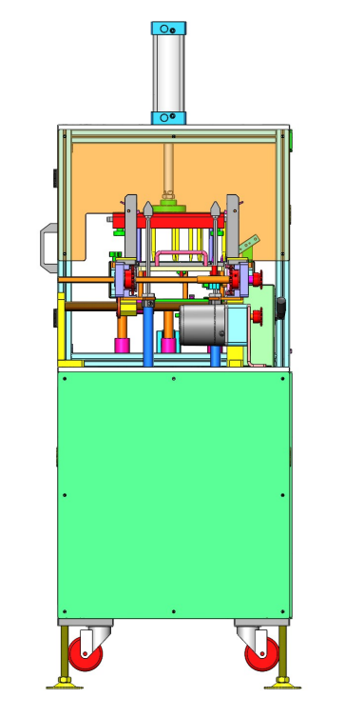
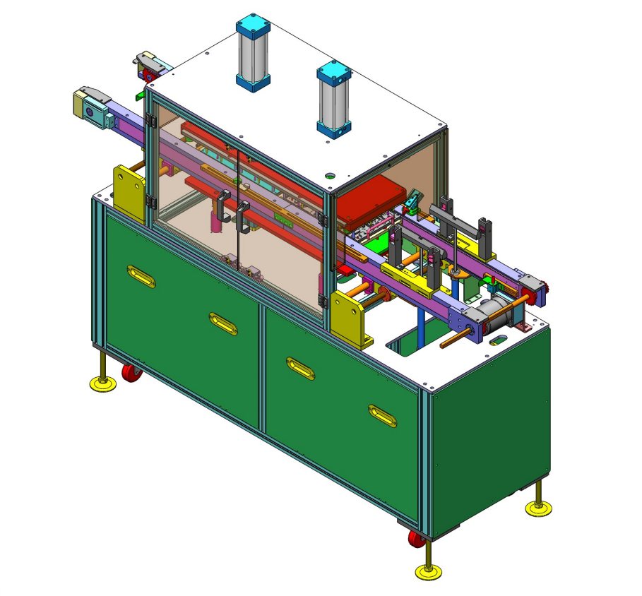
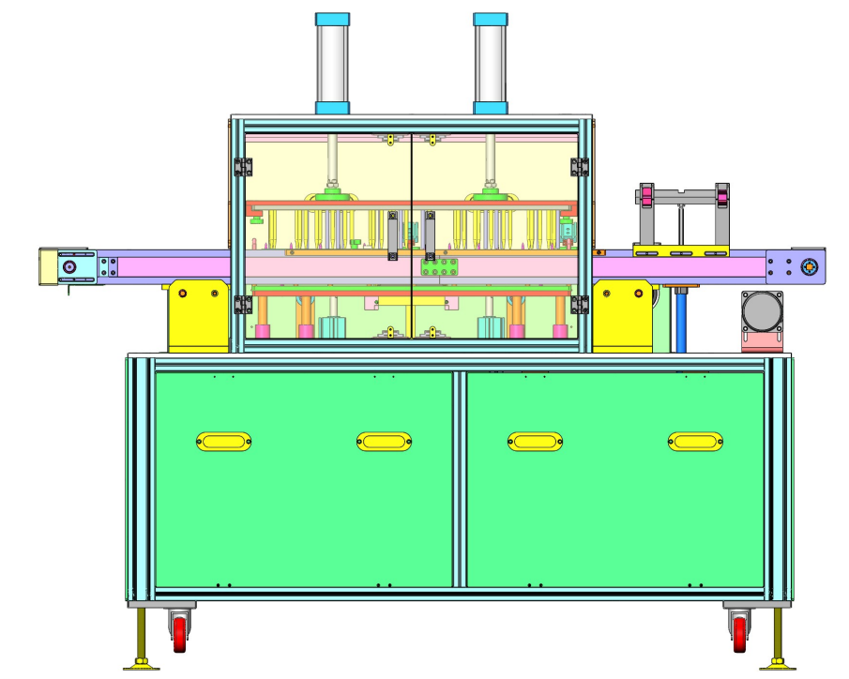
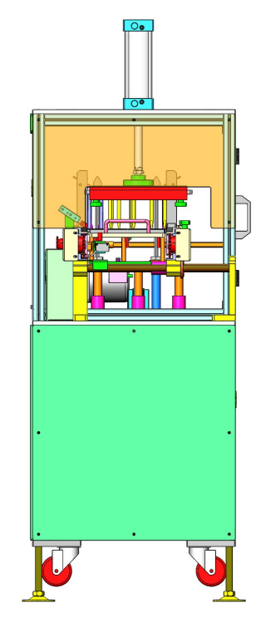
4. Conveyor

Slide 12
TECHNICAL TEAM
2020. 10. 28
Pham Gia Tri
7199252
Ho Van Tan
7209115
DEV 제조1팀

